Slide 1


HYROX- AI Hybrid Warfare Intelligence System
Team Name: I-DASH
Team ID: AIIS164
Track: AI & Intelligent Systems (AIIS)
Team Members:
Ishita Sharma
Amit Kumar Singh
Divyam Gupta
Harshit Srivastava
Name of Institution:
Dr. K. N. Modi Institute of Engineering and Technology,
Modinagar

Slide 2

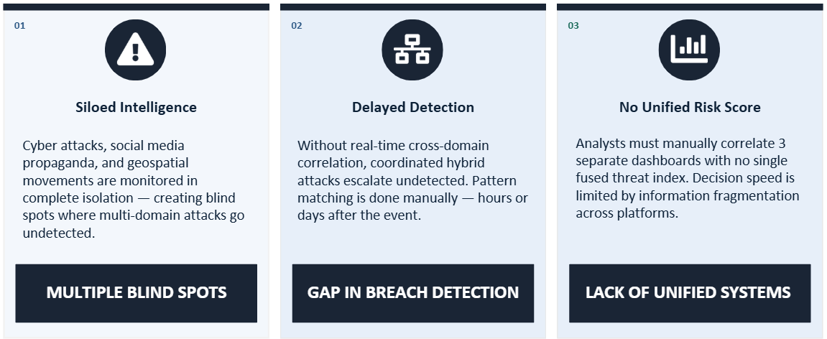
Problem Statement
Problem Statement
2

Slide 3


Proposed Solution / Idea
t
Proposed Solution
INTELLIGENCE PROCESSING PIPELINE:-
DETECT
FUSE
SCORE
ALERT
LLM REPORT
An AI-powered system that fuses heterogeneous, multi-domain intelligence streams in real time to produce a single, actionable, and explainable composite threat score for Indian border security analysts. It applies domain-specific ML models and produces a Unified Threat Picture in real time to Cyber (CYBINT), Social Media (SOCINT), and Geospatial (GEOINT) data :-
SOCINT
CYBINT
GEOINT
Social Media Intelligence
Cyber Intelligence
Geospatial Intelligence
BERT · Transformer · NLP
Isolation Forest · Autoencoder
XGBoost Classifier · Spatial Clustering
■ NLP headline analysis
■ Narrative trend scoring
■ Disinformation tagging
■ Sentiment geofencing
■ Influence-op detection
■ AbuseIPDB integration
■ Malicious IP clustering
■ Attack-origin heatmaps
■ TTPs fingerprinting
■ CVE correlation engine
■ Spatial clustering using BiLSTM
■ Anomaly zone mapping
■ Incident concentration
■ Cross-border patterns
■ Satellite data-ready
3 W
3

Slide 4
Proposed Solution / Idea
Problem Statement
Innovation & Uniqueness
Multi-Domain Intelligence Fusion
First platform to seamlessly integrate SOCMINT, CYBINT, and GEOINT into a unified analysis framework
Cross-Domain AI Anomaly Detection
AI models trained to detect anomalies and patterns across cyber, social, and geospatial domains simultaneously
Unified Threat Scoring System
Proprietary weighted algorithm that aggregates threat indicators from all domains into a single score
Automated LLM Intelligence Reports
Generates comprehensive, human-readable intelligence summaries using advanced language models
Modular & Scalable Architecture
Plugin-based design enables easy addition of new intelligence sources and AI models
4 W
4

Slide 5
Proposed Solution / Idea
Problem Statement
Technology Used
Intelligence (Python ML)
Layered Architecture
XGBoost
SBERT
Isolation Forest
Presentation Layer
Streamlit Dashboard
Fusion
XGBoost Regressor
AI/ML Layer
Python ML models
AI Report (LLM)
Data Processing Layer
Ollama
UI
Data Sources Layer
Streamlit
Folium/Plotly
SOCMINT, CYBINT, GEOINT
5 W
5

Slide 6
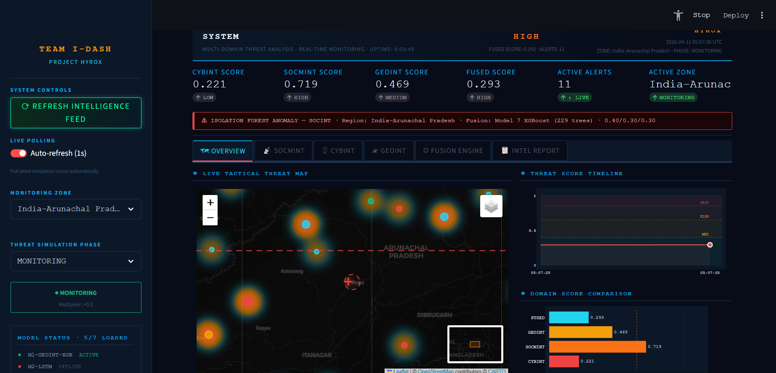
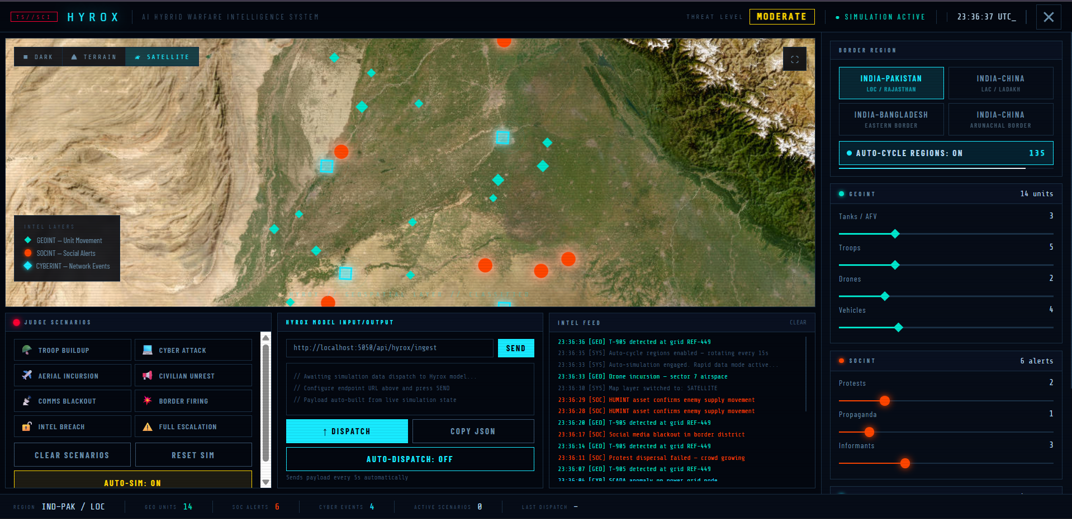
Proposed Solution / Idea
Problem Statement
Features & Functionalities
CYBINT Module: Malicious IP clustering, attack-origin heatmaps, and TTPs fingerprinting.
SOCINT Module: NLP headline analysis, disinformation tagging, and influence-op detection.
GEOINT Module: XGBoost spatial clustering and anomaly zone mapping.
Automated Briefings: LLM-generated, analyst-ready briefings to replace hours of manual reporting.
Interactive Interface: Live Streamlit dashboard rendering interactive world threat maps.
6 W
6

Slide 7
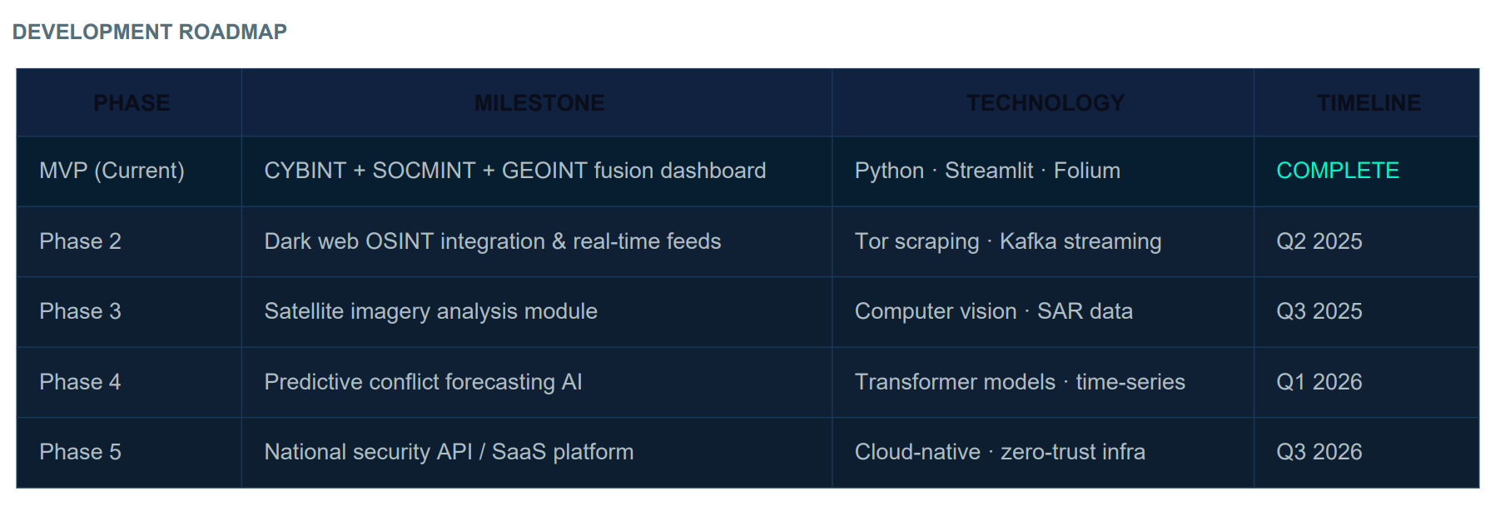
Proposed Solution / Idea
Problem Statement
Implementation Roadmap
This roadmap outlines our platform's evolution from the completed multi-domain MVP to a cloud-native National Security SaaS platform by Q3 2026.
Upcoming phases will integrate dark web OSINT, satellite imagery, and transformer models to shift our capabilities from real-time detection to predictive conflict forecasting.
PHASE
MILESTONE
TECHNOLOGY
TIMELINE
7 W
7

